Slide 1
Sheep Sleep
? – What do you think this story is about?

Slide 2
A horse met a sheep. The sheep said, “I can trot faster than a sheep.” The sheep got mad. Then the horse said, “and I can swim faster than a sheep.” The sheep said, “But I can do this better than a horse.” The sheep went to sleep.

Slide 3
Questions ?
What did the horse say first?
What happened last?
Why did the sheep get mad? (look back?)
What can the horse do better than a sheep?
What can a sheep do better than a horse?
Why is a horse faster than a sheep?

Slide 4
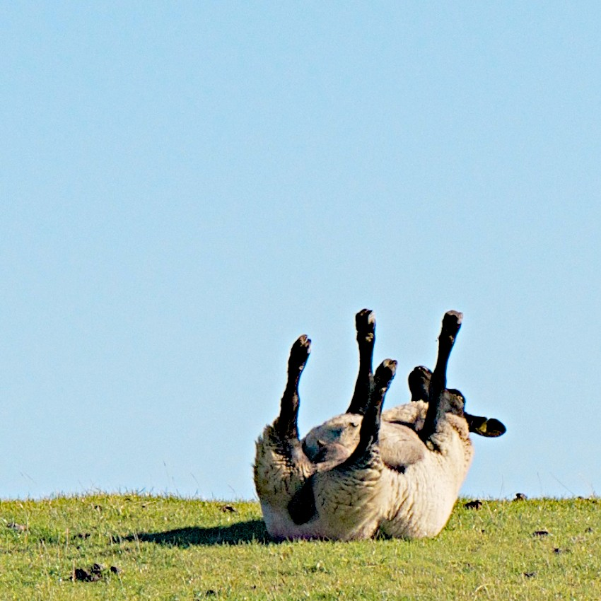

Slide 5
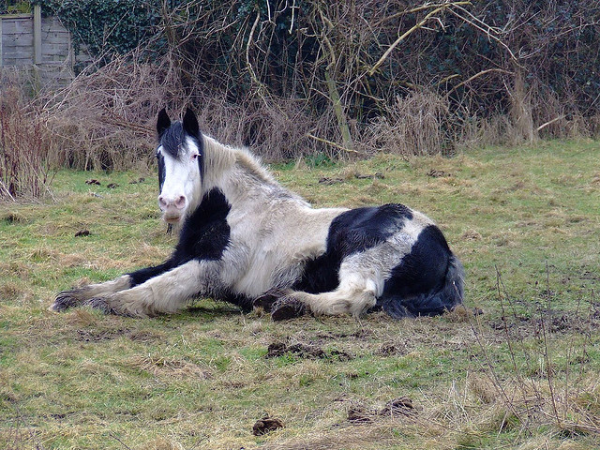
Is this horse fast?

