Slide 1
Fishing Fun
? – What do you think this story is about?

Slide 2
Bill went fishing with the other boys. The other boys had lots of fish, but Bill did not get nine fish or five fish. He got a big old bag. They said, “We have fish and you have an old bag.” Bill was sad.

Slide 3
Why was Bill sad?
What do you think is in the bag?

Slide 4
Then he said, “Wow! This bag is filled with gold.” The other boys looked inside the bag. “Wow!” they said.
Now Bill was not sad. He said to the other boys, “You have lots of fish, but I have lots and lots of gold, so I am rich!”

Slide 5
Questions ?
Did Bill catch any fish?
What happened last?
Where did the gold come from?
Which would you rather have gold or fish?
What will Bill do with the gold?
What would you do with the gold?

Slide 6
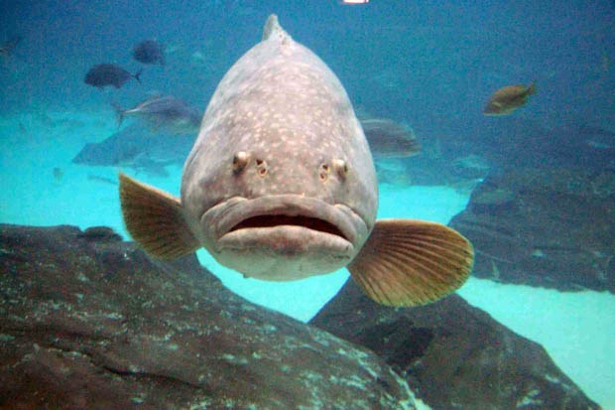
Notes:
What is this fish thinking?

Slide 7
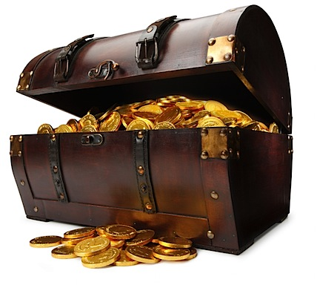
What can you buy with this?

